Slide 1

RollMaster
Inventory Usage Report
This report displays current stock levels based on previous sales rates to help determine sustainable stock levels. You can quickly analyze a large amount of stock inventory, while also reviewing backup sales and stock information, all from one easy to use report.

Slide 2
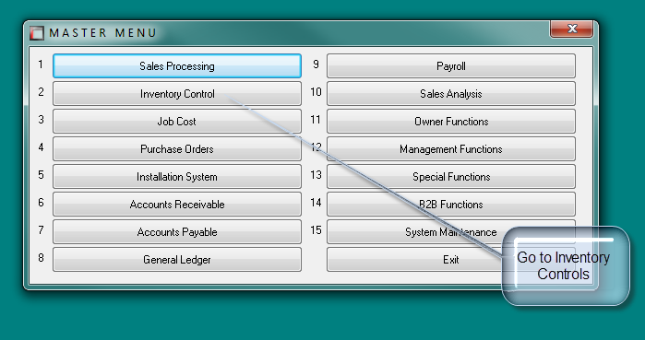
To Find This Report

Slide 3
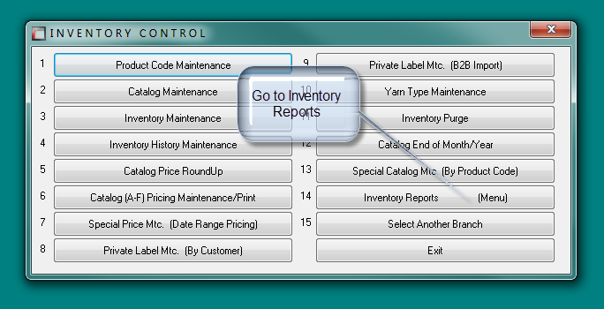
To Find This Report

Slide 4
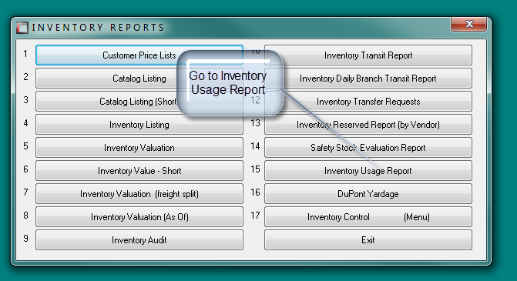
To Find This Report

Slide 5
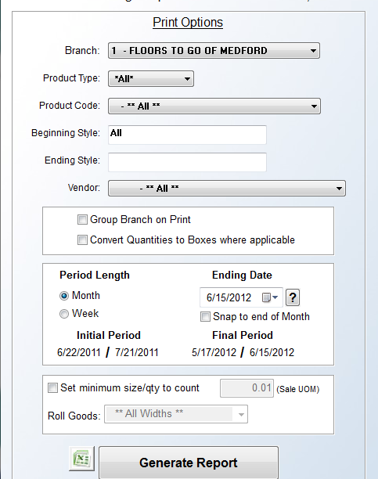
Select your Branch

Slide 6
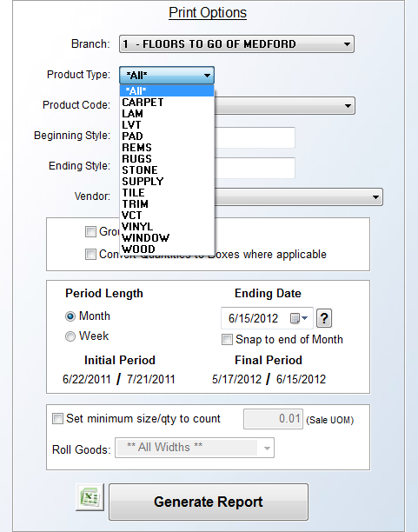
Select a Product Type

Slide 7
You can search by one style…
Or search a range of styles alphabetically

Slide 8
Select a Vendor, if applicable

Slide 9
This reports runs for
12 periods only
Run report by Month and see last 12 months
Run report by Week and see last 12 weeks

Slide 10
All New
Inventory
Usage
Report
Click here to print to Excel
Run report

Slide 11
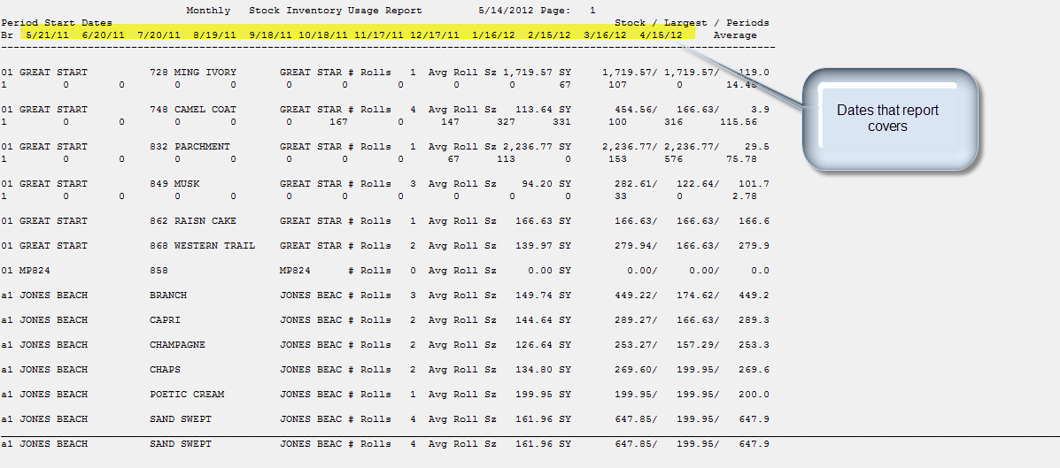

Slide 12
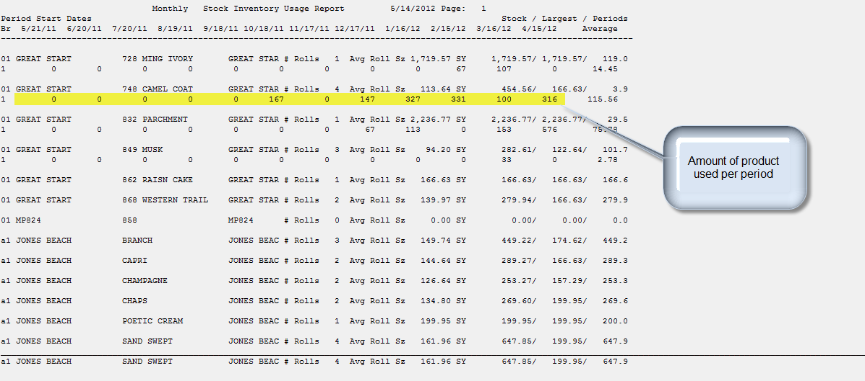

Slide 13
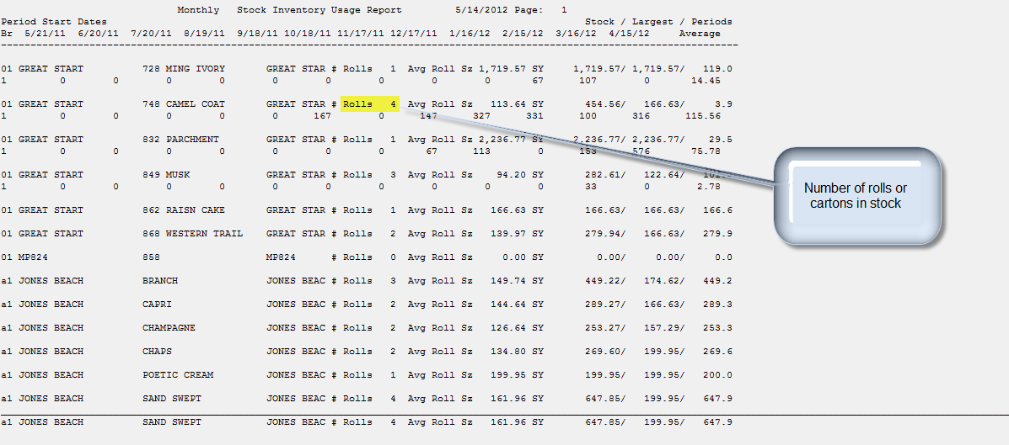

Slide 14
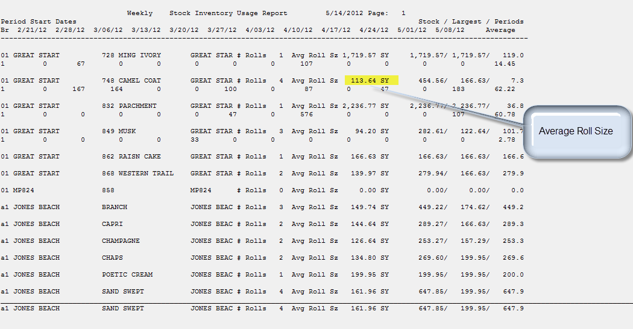

Slide 15
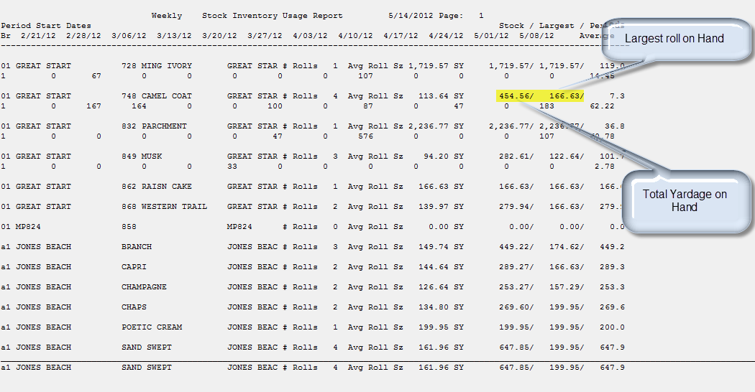

Slide 16
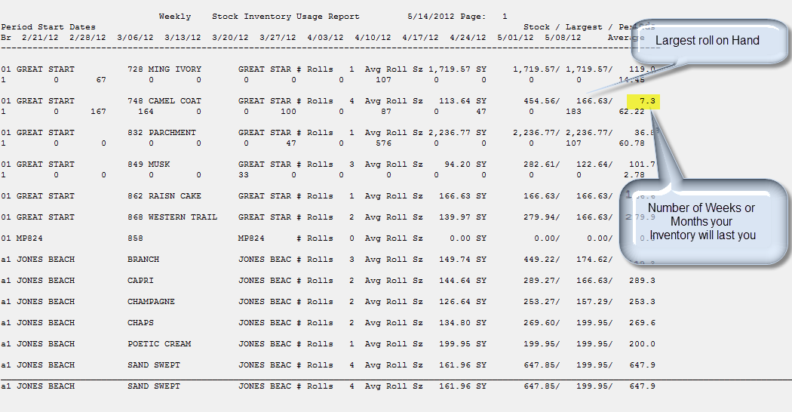

Slide 17
